Slide 1
This class
BFS for state space trees
Branch and bound
  Uses BFS
    Knapsack problem
  Using Best first search
    Feasibility problems
      15 puzzle
  Optimality problems
    Knapsack
    Traveling salesman

Slide 2
Branch and Bound
Similar to backtracking – pruned state space tree is used
Main difference: branch and bound does not limit way of traversing the tree
Branch and bound algorithms use breadth-first-search, best-first-search, etc.

Slide 3
BFS for state space trees initialize
void BFS(tree T)
{
queue_of_node Q; node u,v;
init(Q);
v=root of T;
visit v;
enqueue(Q, v);

Slide 4
BFS for trees - main
while (! empty(Q)) {
dequeue(Q, v);
for (each child u of v) {
visit u;
enqueue(Q, u);}
}
}

Slide 5
Branch and bound with breadth first search
Uses the following functions:
  Value(v) computes the current solution at v
  Bound(v) computes a bound (upper for maximization, lower for minimization) on the value of the best solution that can be achieved by expanding v
Only nodes with bound(v) better than best are expanded (note best may have improved since v was added to queue)
The queue is a FIFO queue

Slide 6
Branch and bound with breadth first search
The value of the each child u is used to update best
Only children u with bound(u) better than best are added to the queue

Slide 7
BFS branch and bound
void BFS_B&B(st_sp_tr T,
number& best) {
queue_of_node Q; node u, v;
initialize(Q);
v=root of T;
best=value(v);
insert(Q,v);

Slide 8
BFS branch and bound
while (! empty(Q)) {
remove(Q, v);
if (bound(v) is better than best)
for (each child u of v) {
if (value(u) is better than best)
best=value(u);
if (bound(u) is better than best)
insert(Q, u) }}}

Slide 9
Procedure Knapsack
Each “node” has: level, profit, weight
void knapsack2(int n,
const int p[ ], const int w[ ],
int W, int& maxprofit); {
queue_of_node Q; node u,v;
//initialize
init(Q); maxprofit=0; //v is root
  v.level=0; v.profit=0; v.weight=0;
  enqueue(Q, v);

Slide 10
Procedure Knapsack
while (! empty(Q)) {
dequeue(Q, v);
//include (v.level +1) item (“yes” child)
u.level= v.level+1; //u child of v
u.weight= v.weight+w[u.level];
u.profit= v.profit+p[u.level];
  //update maxprofit
  if ((u.weight<=W) &&
  (u.profit>maxprofit))
maxprofit=profit;

Slide 11
Procedure Knapsack
//add to queue if bound > maxprofit
if (bound(u)>maxprofit)
enqueue(Q, u);
//Exclude (v.level+1) item (“no” child)
u.weight= v.weight; //not included
u.profit= v.profit;
//add to queue if bound > maxprofit
if (bound(u)>maxprofit)
enqueue(Q, u);
}}

Slide 12
Best-first search for goal based problems
DFS and BFS searches do not use node information to improve the search
Uses information about the “distance of a node from the goal” to guide the search towards the goal

Slide 13
Best-First Search for goal based problems
Similar to breadth first search
Uses priority queue Instead of queue
Nodes in priority queue ordered by distance from goal
insert(PQ, v) inserts v into the priority queue with key=dist(v)
remove(PQ, v) removes the key with the highest priority from the PQ

Slide 14
Best-First Search for goal based problems
node BestFS(node s)
{
node u;
priority_queue PQ;
init(PQ);
insert(PQ, s);

Slide 15
Best-First Search
while (! empty(PQ)){
remove(PQ, u);
if (dist(u)==0) return (u)
for (each child v of u)
  insert(PQ, v);
}
}

Slide 16
The 15-puzzle: an example
The distance of a node to the goal = number of tiles
That are not in the goal position
d(initial-state, goal state)=13 (1, and 11 are in goal
position
1 | 3 | 4 | 15
2 |  | 5 | 12
7 | 6 | 11 | 14
8 | 9 | 10 | 13
1 | 2 | 3 | 4
5 | 6 | 7 | 8
9 | 10 | 11 | 12
13 | 14 | 15
Initial state Goal state

Slide 17
B&B with best-first search for optimality problems
Branch and bound with best-first search for maximum:
Nodes with the highest upper bounds have the potential of producing the optimal solution and therefore should be the first to expand

Slide 18
Best-first branch and bound
void best_first_B&B(st_sp_tr T,
number& best) {
priority_queue PQ; node u, v;
//initialize
initialize(PQ);
v=root of T;
best=value(v);
insert(PQ,v);

Slide 19
Best-first branch and bound
while (! empty(PQ)) {
remove(PQ, v);
if (bound(v) is better than best)
//Expand v if can lead to better solution
for (each child u of v) {
if (value(u) is better than best)
best=value(u);
//Add u to PQ if bound(u) better
if (bound(u) is better than best)
insert(PQ, u) }}}

Slide 20
Procedure Knapsack
void knapsack3(int n,
const int p[ ], const int w[ ],
int W, int& maxprofit); {
priority_queue_of_node Q;
node u,v;
init(PQ); maxprofit=0; //v is root
  v.level=0; v.profit=0;
  v.weight=0; v.bound=bound(v)

Slide 21
Procedure Knapsack
  enqueue(PQ, v);
while (! empty(PQ)) {
remove(PQ, v); //with best bound
if (v.bound>maxprofit) {//expand v
//Include item v.level+1
u.level= v.level+1; //u child of v
u.weight= v.weight+w[u.level];
u.profit= v.profit+p[u.level];

Slide 22
Procedure Knapsack
if ((u.weight<=W) &&
  (u.profit>maxprofit))
maxprofit=profit;
if (bound(u)>maxprofit)
insert(PQ, u);

Slide 23
Procedure Knapsack
//Exclude item v.level+1
u.weight= v.weight; //not included
u.profit= v.profit;
u.bound=bound(u)
if (u.bound>maxprofit)
insert(PQ, u);
}//node not expanded
} //queue is empty
}

Slide 24
float bound(node u){
  index j, k;
  int totweight;
  float result;
  if (u.weight>=W) return 0;
  else {
  result = u.profit
  j =u.level+1
  totweight = u.weight;

Slide 25
Cont.
  while (j<=n && totweight+w[j] <=W){
  totweight =totweight +w[j]
  result = result +p[j];
  j++;}
  k=j;
  if (k<=n) // use fraction of item
  result = result+ (W-totweight)*p[k]/w[k];
  return result;

Slide 26
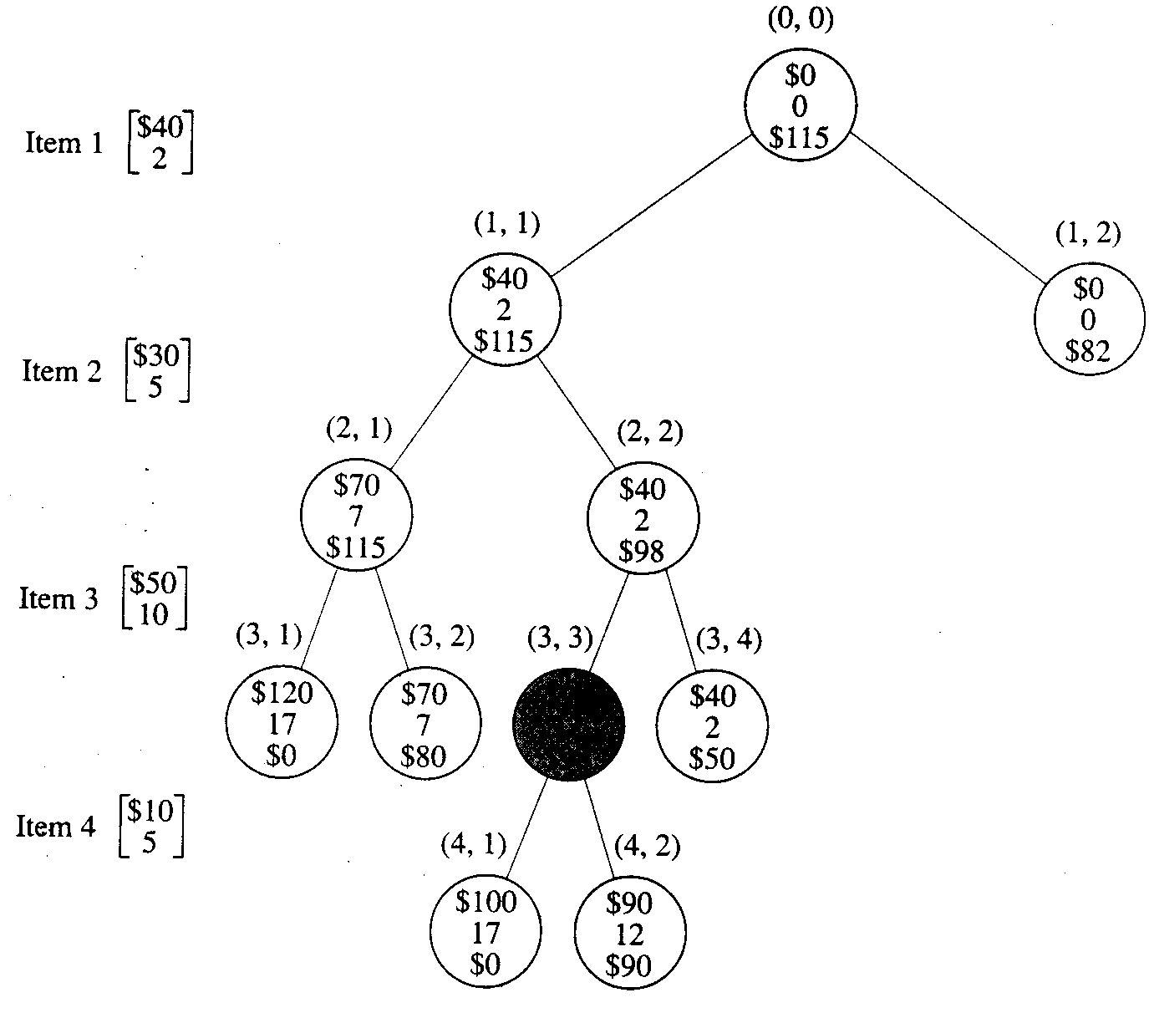
Best first B&B state space tree
(level, child)
$90
12
$98

Slide 27
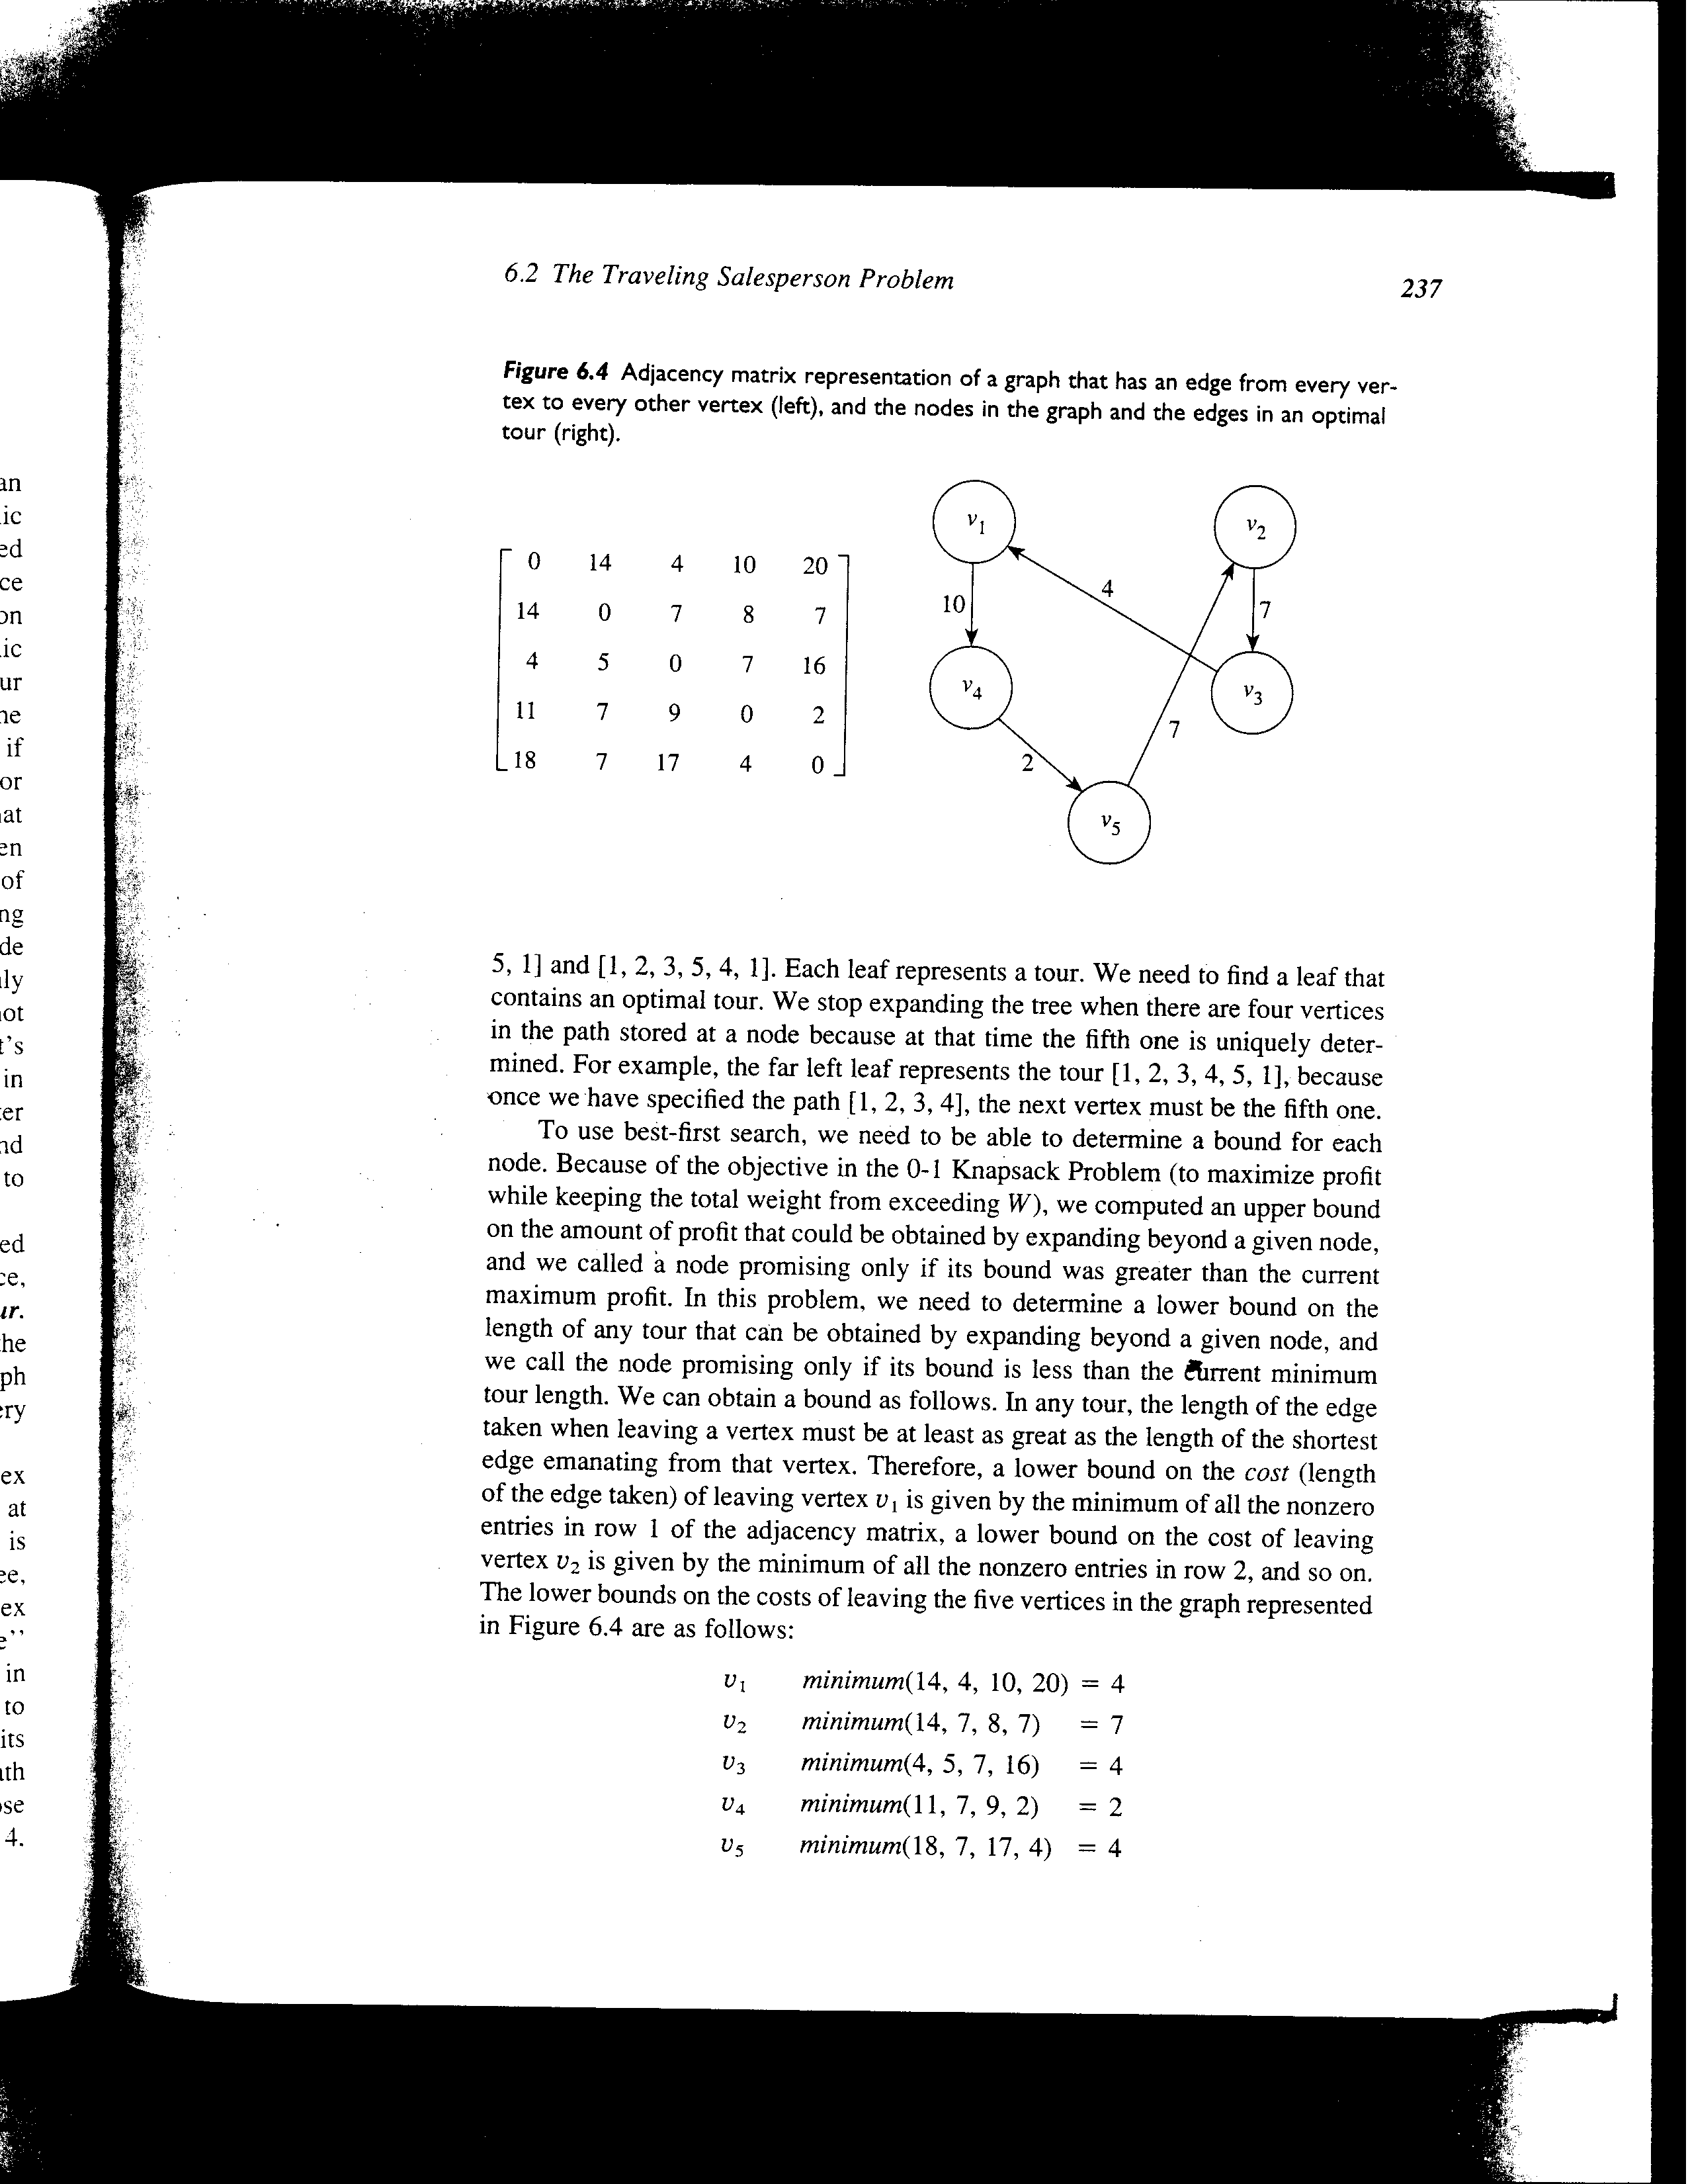
Traveling salesman
Given m cities, and the distances between
every pair of cities, find a minimum distance cycle
that includes each city exactly once

Slide 28
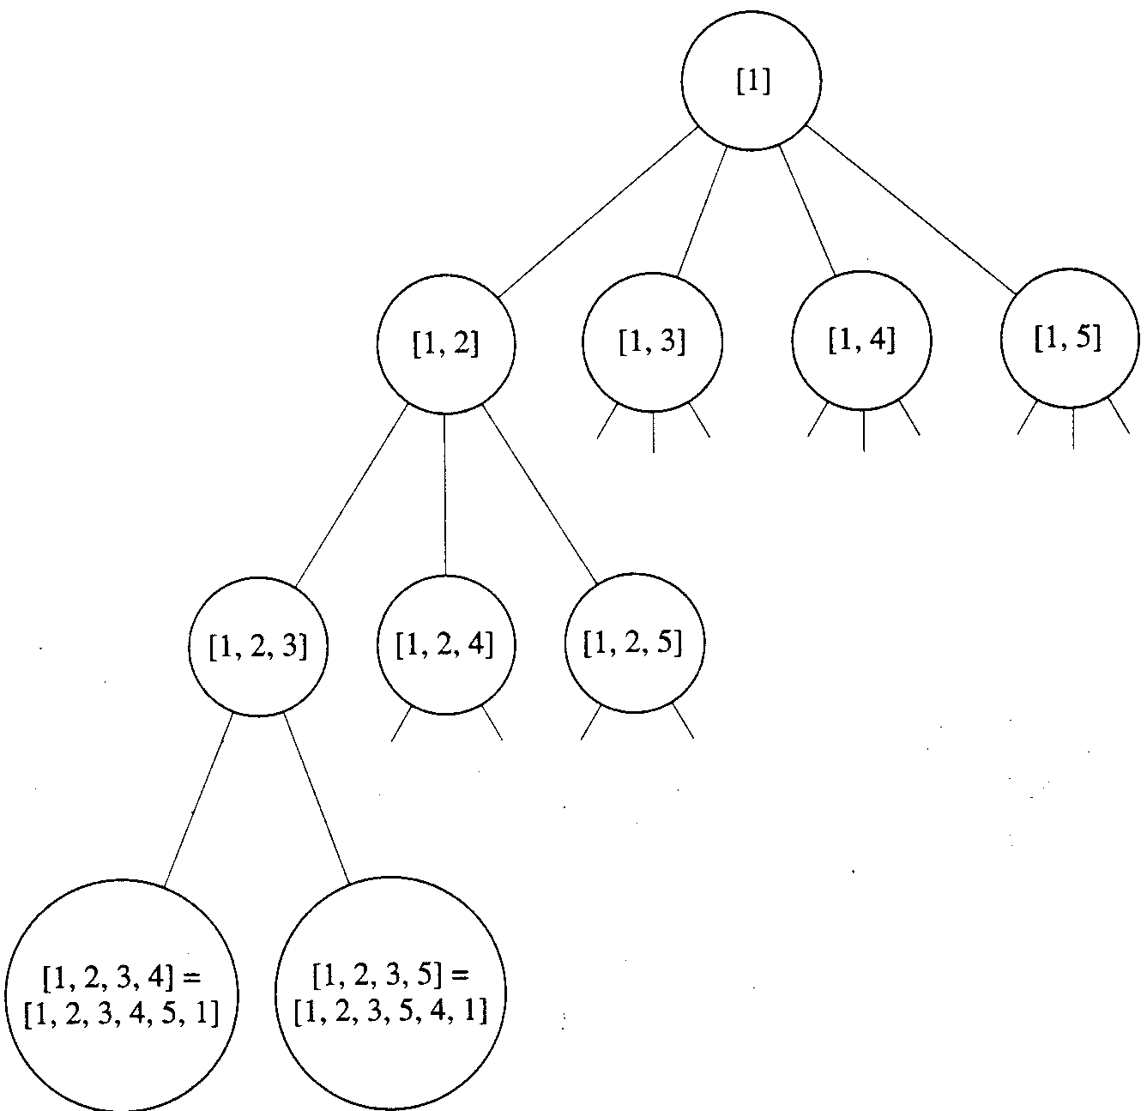
A partial state space tree

Slide 29
The initial bound
Assume a tour starts at node 1.
An initial lower bound can be computed by:
So the initial bound is 4+7+4+2+4=21

Slide 30
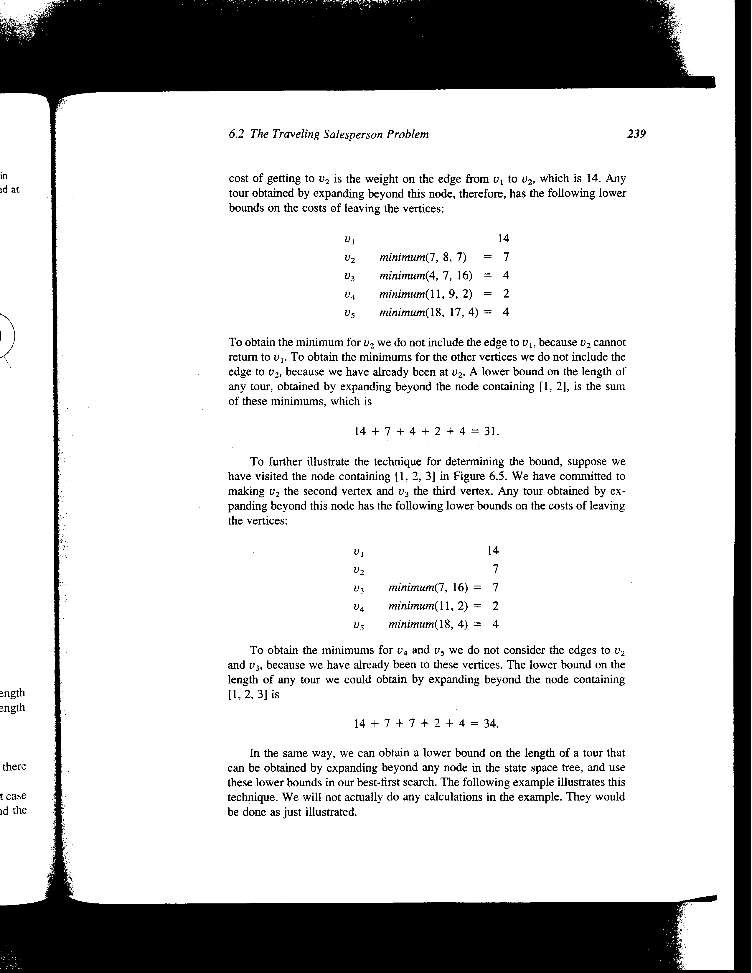
The bound for path [1, 2]
For v₂, we exclude the edge to v₁
For v₃, v₄, and v₅, we exclude the edge to v₂
The bound is: 14+7+4+2+4=31

Slide 31
The bound for the path
[1, 2, 3]
For v₃, we exclude the edge to v₁, or v₂
For v₄, and v₅, we exclude the edge to v₃, or v₂
The bound is 14+7+7+2+4=34

Slide 32
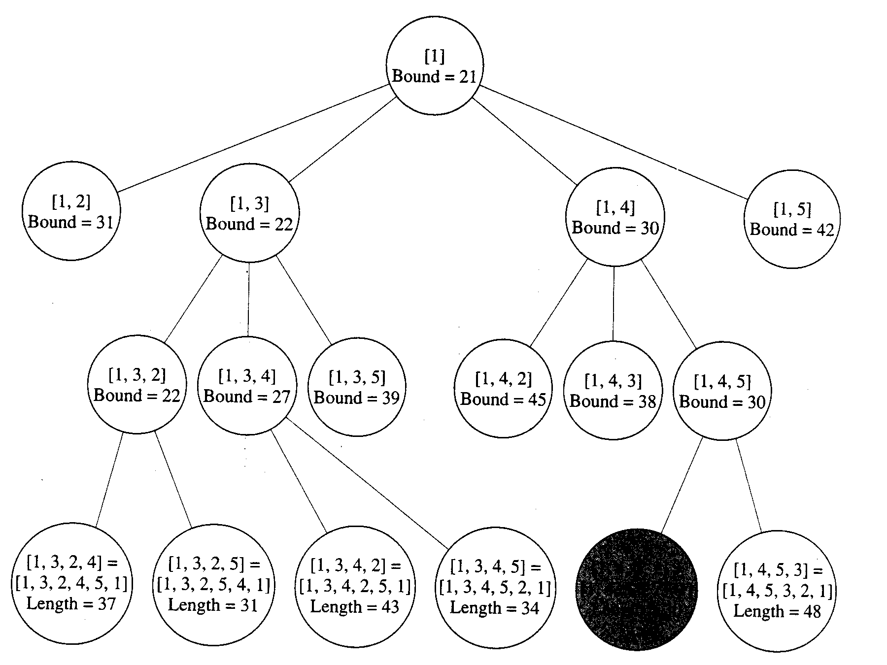
The state space tree for traveling salesman
[1,4,5,2]=
[1,4,5,2,3,1]
Length=30

Slide 33
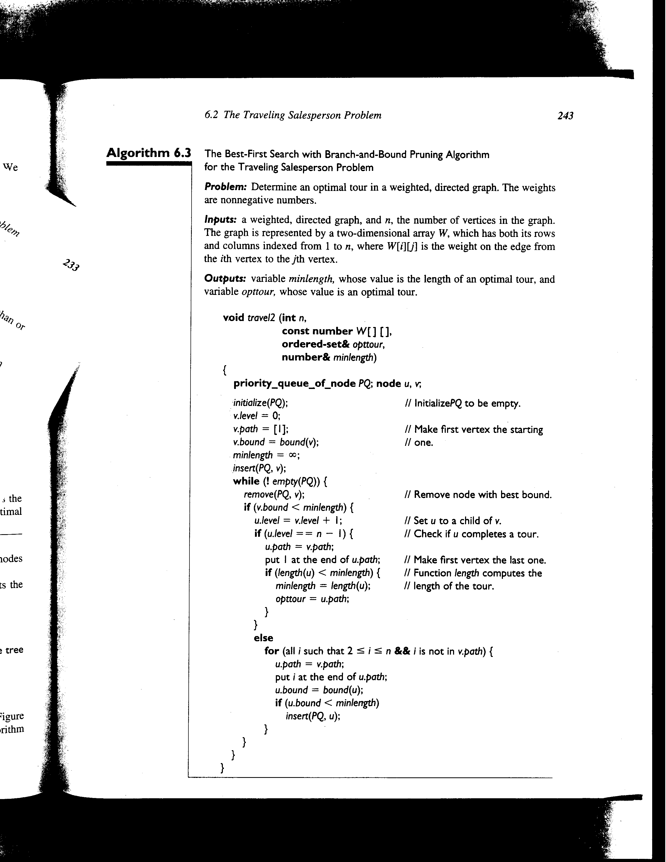
B&B with best first search for Traveling Salesman
//Weight matrix for TSP

Slide 34
==(n-2)
Add missing vertex not in v.path to u.path

